Slide 1
Project Proposal
on Currency Exchanger
Submitted To:
Shagun Sharma
Tushar Khitoliya
Submitted by:
Karan Kumar Garg
2210990478
Chitkara University Institute of Engineering and Technology (CUIET)
Chitkara University, Punjab

Slide 2
Outline
Introduction
Motivation
Justification for Project
Problem Statement
Objective
Methodology
Work Plan
Input
Expected Outcomes
References

Slide 3
Introduction
1. Currency exchanger is a simple app that should enable user to check currency rates
2. It user tkinter module with a very attractive interface
3. All the Calculations are managed by computer so calculations are much faster

Slide 4
Motivation
1. The main motivation for this project was to make the interface that can do real time conversions and was user friendly.
2. Also to make currency much faster and more accurate

Slide 5
Justification for Project
1. Use of interface and various other modules makes for a better currency exchange program
2. It is all made using python which makes it easier to add more features in future

Slide 6

Problem Statement
1. Make a interface using tkinter module
2. Make a program to check real time currency rates using forex python
3. Implement the forex python module to do real time conversions

Slide 7
Methodology
1. Tkinter module was created with the help of documentations and various other buttons and input boxes were added
2. Code was written to convert real time rates using forex python (write it in bit more detail on how it works since I don't know the code)

Slide 8
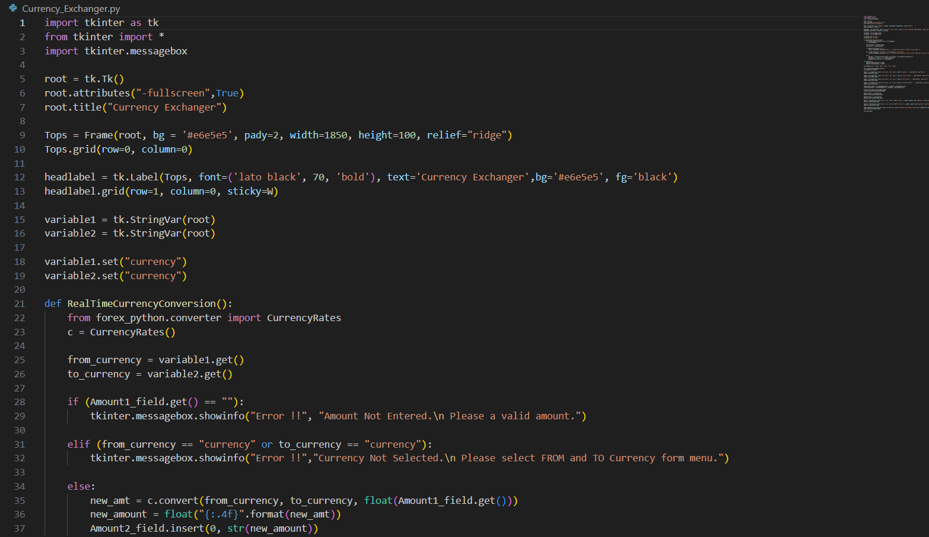
Input

Slide 9
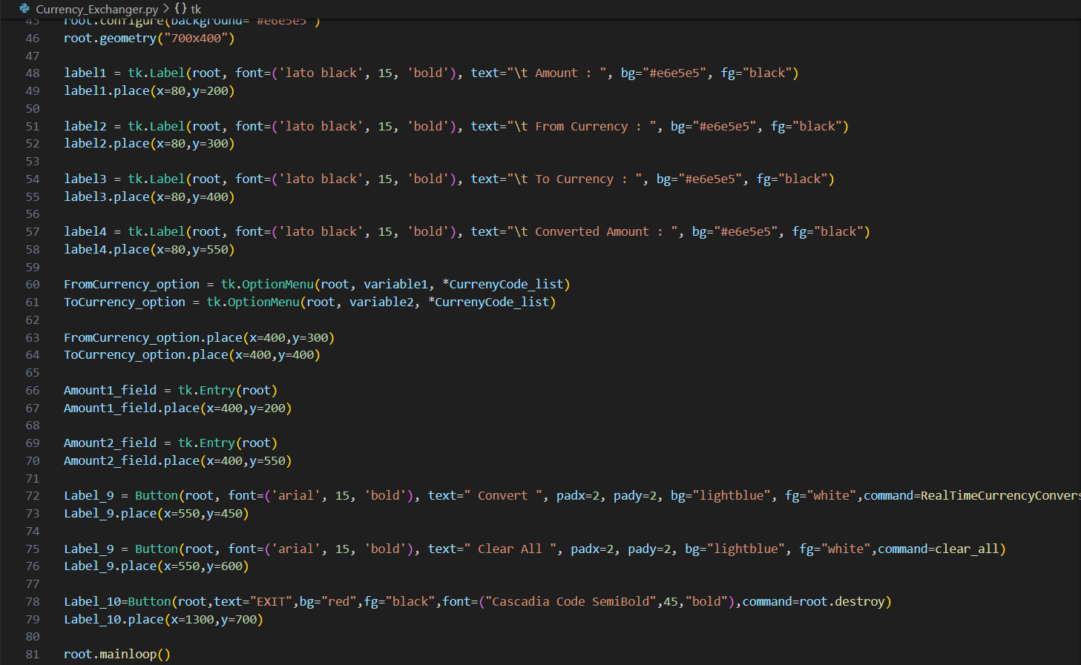

Slide 10
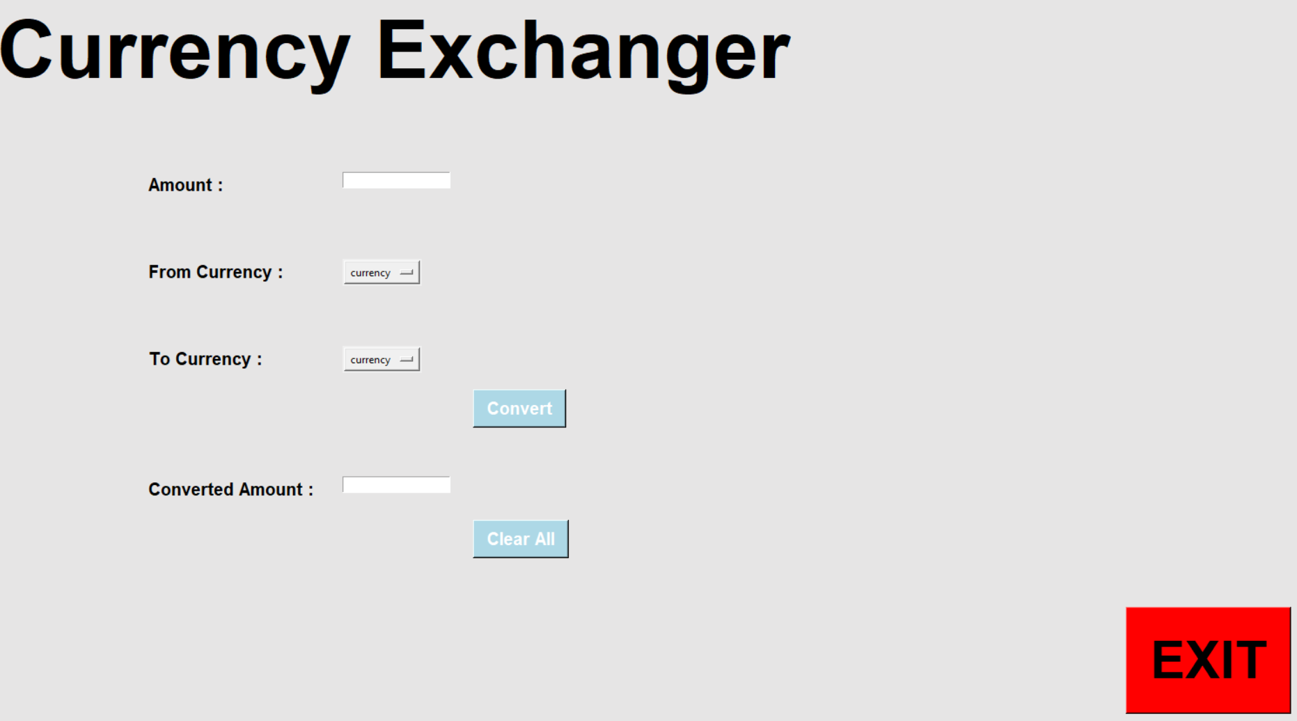
Expected Outcomes
1. Real time conversion is done and the results are displayed

Slide 11
References
1. geeks for geeks
2. Python documentation
3. Forex python documentation

Slide 12
Thank You

